Slide 1
UI BASICS
CONTENT

Slide 2
CONTENT
HTML Inline & Block Elements
HTML Elements
Semantic HTML Elements
CSS Selectors
CSS Specificity
CSS Colors
Exercises

Slide 3
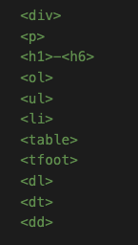
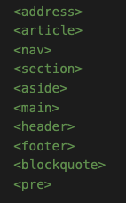
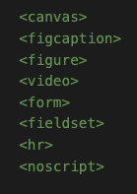
INLINE & BLOCK ELEMENTS
Block-Level Elements
A BLOCK-LEVEL ELEMENT always starts on a new line and takes up the full width available (stretches out to the left and right as far as it can).

Slide 4
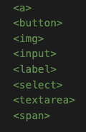
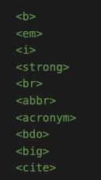
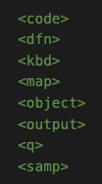
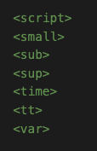
INLINE & BLOCK ELEMENTS
Inline-Level Elements
AN INLINE ELEMENT does not start on a new line and it only takes up as much width as necessary.

Slide 5
INLINE & BLOCK ELEMENTS
<div> vs. <span>
The <div> element is often used as a container for other HTML elements.
The <div> element has no required attributes, but style, class and id are common.
When used together with CSS, the <div> element can be used to style blocks of content
BLOCK Element
The <span> element is an inline container used to mark up a part of a text, or a part of a document.
The <span> element has no required attributes, but style, class and id are common.
When used together with CSS, the <span> element can be used to style parts of the text
INLINE Element
vs.

Slide 6
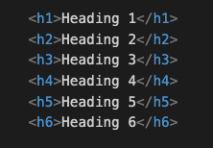
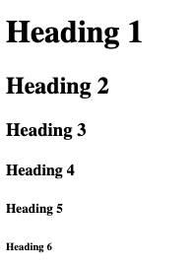
HTML ELEMENTS
HEADINGS
NOTE :
Browsers automatically add some white space (a margin) before and after a heading.
Search engines use the headings to index the structure and content of your web pages.

Slide 7
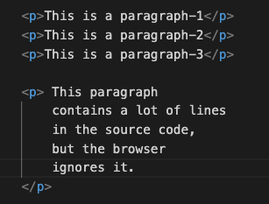
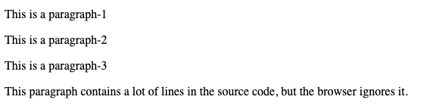
HTML ELEMENTS
PARAGRAPHS
NOTE :
Browsers automatically add some white space (a margin) before and after a paragraph.
A paragraph always starts on a new line, and is usually a block of text (Block Element).
With HTML, you cannot change the display by adding extra spaces or extra lines in your HTML code. Because the browser will automatically remove any extra spaces and lines when the page is displayed.

Slide 8
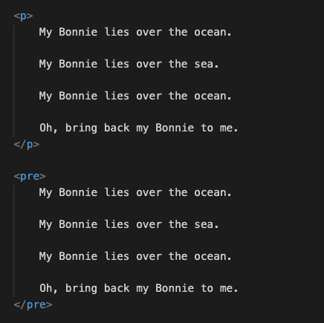
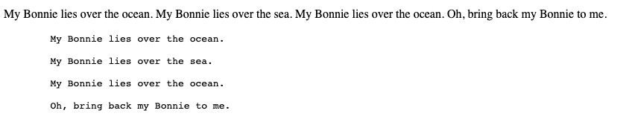
HTML ELEMENTS
PARAGRAPHS & <PRE> TAG
NOTE :
The HTML <pre> element defines preformatted text.
The text inside a <pre> element is displayed in a fixed-width font (usually Courier), and it preserves both spaces and line breaks

Slide 9
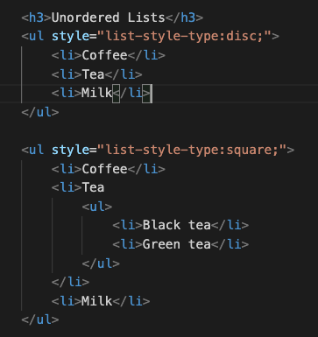
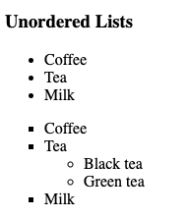
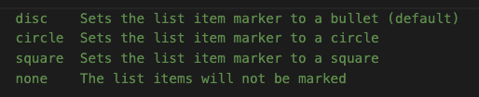
HTML ELEMENTS
LISTS __ Unordered Lists
<ul style="list-style-type:'\2b50';">

Slide 10
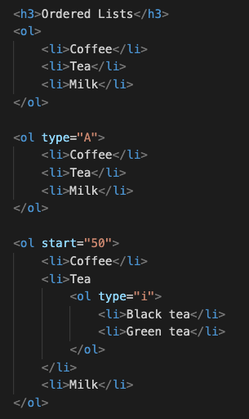
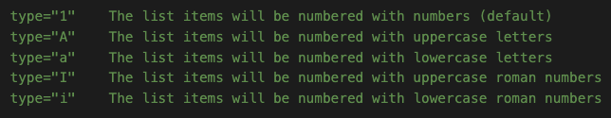
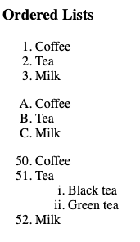
HTML ELEMENTS
LISTS __ Ordered Lists
OR
CSS : list-style-type
<ul style="list-style-type:'\2b50';">
NOTE :
By default, an ordered list will start counting from 1. If you want to start counting from a specified number, you can use the "start" attribute

Slide 11
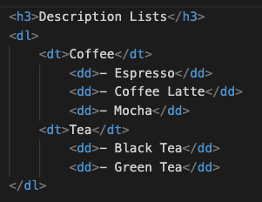
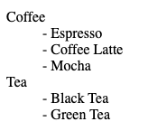
HTML ELEMENTS
LISTS __ Description Lists
NOTE :
<dl> : the description list,
<dt> : the term (name),
<dd> : each term

Slide 12
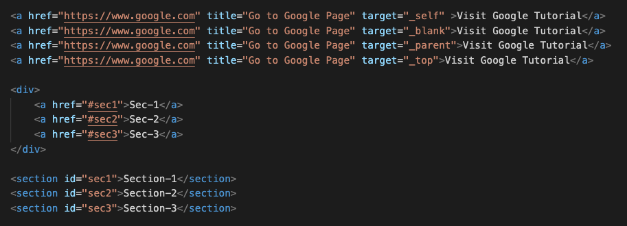
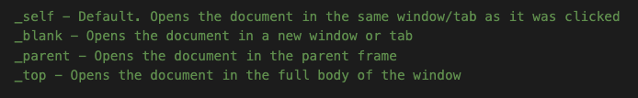
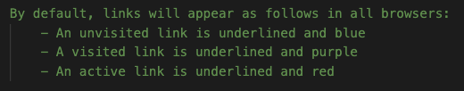
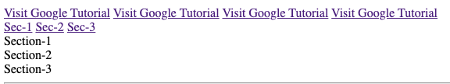
HTML ELEMENTS
Links - Hyperlinks

Slide 13
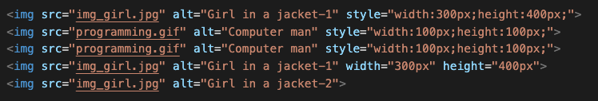

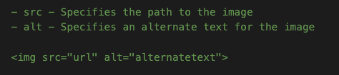
HTML ELEMENTS
Images

Slide 14
HTML ELEMENTS
Semantic HTML Elements
Semantic elements = elements with a meaning
A semantic element clearly describes its meaning to both the browser and the developer.
Examples of non-semantic elements: <div> and <span> - Tells nothing about its content.
Examples of semantic elements: <form>, <table>, and <article> - Clearly defines its content.

Slide 15
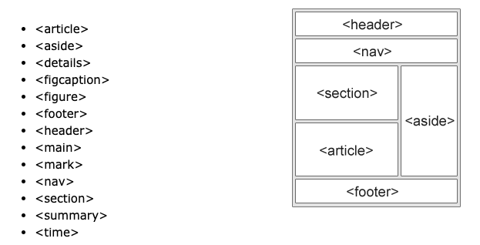
HTML ELEMENTS
Semantic HTML Elements
They serve only as holders to convey to the browser how the content should be displayed. They give no information about the role, the content they contain, plays on the page.
Semantic elements = elements with a meaning
<div class="header"> … </div>
<div class="nav"> … </div>
<div class="footer"> … </div>
<header class=”aaa"> … </header>
<nav class=”bbb"> … </nav>
<footer class=”ccc"> … </footer>
This explicit information helps robots/crawlers like Google and browsers to better understand which content is important, which is for main section, which is for navigation, and so on.

Slide 16
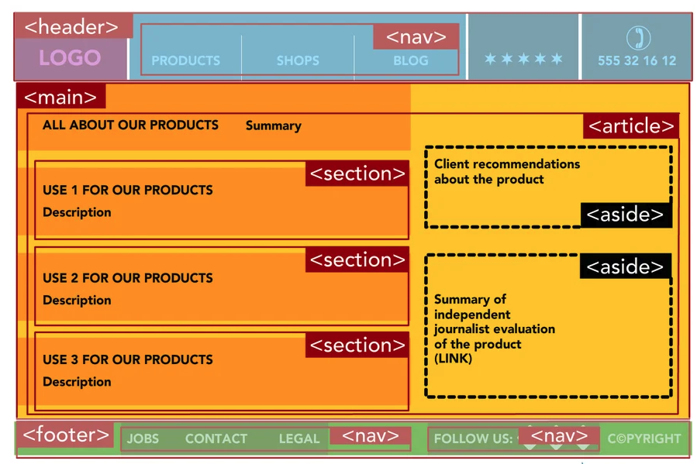
HTML ELEMENTS
Semantic HTML Elements

Slide 17
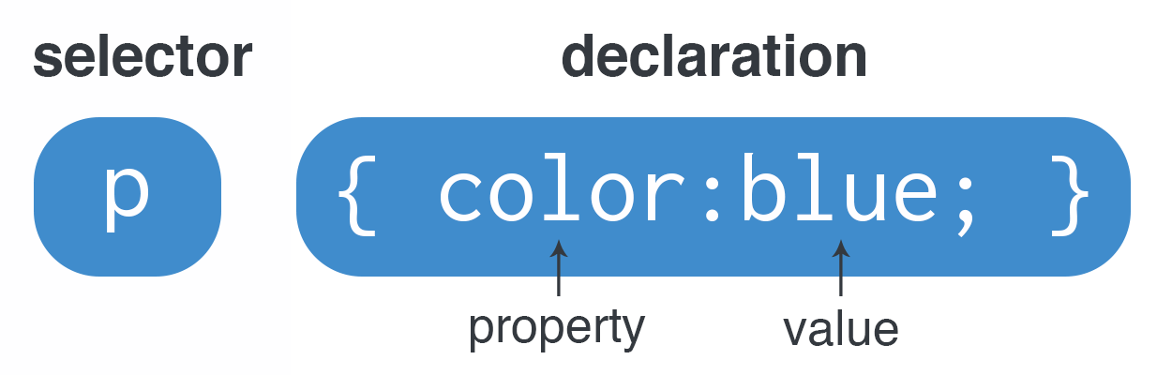
CSS
SELECTORS
https://www.w3schools.com/cssref/css_selectors.asp
https://flukeout.github.io/
Simple selectors (element name, id, class)
Combinator selectors (select elements based on a specific relationship between them)
- descendant selector (space)
- child selector (>)
- adjacent sibling selector (+)
- general sibling selector (~)
Pseudo-class selectors (select elements based on a certain state, :hover, :active, :first-child)
Pseudo-elements selectors (select and style a part of an element, ::after, ::before, ::first-letter)
Attribute selectors (select elements based on an attribute or attribute value, a[target="_blank"], [class|="top"] )

Slide 18
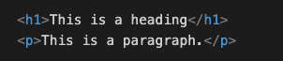
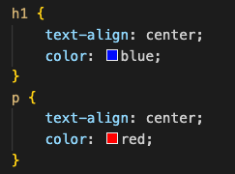
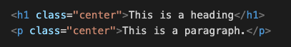
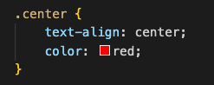
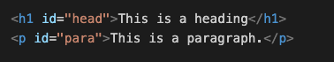
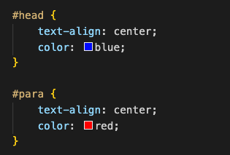
CSS
NOTE :
class and id names
- are case sensitive
- must not contain whitespaces
- cannot start with a number!
SELECTORS -- Simple selectors
HTML Elements
class
id

Slide 19
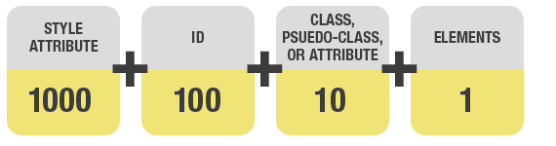
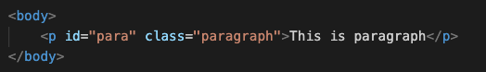
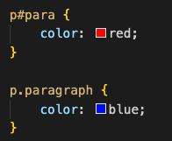
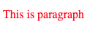
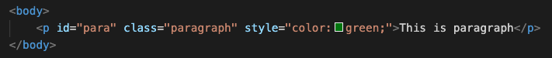
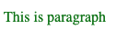
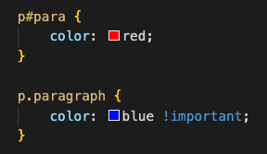
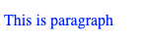
CSS
!important;
10.000
+
SPECIFICITY
100 + 0 + 1 = 101
0 + 1 + 1 = 11
1000
10.000 + 0 + 0 + 10 + 1 = 10.011

Slide 20
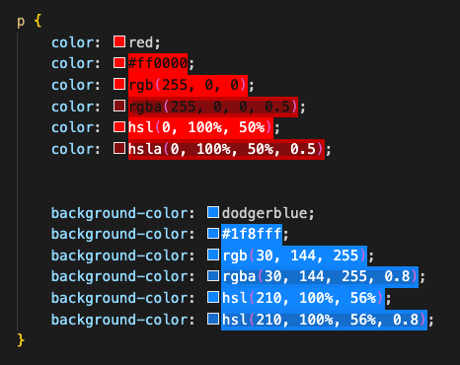
CSS
COLORS
Name of color
HEX #RRGGBB 00 → FF
RGB or RGBA rgb(red, green, blue) 0 → 255
rgba(red, green, blue, alpha) 0.0 – 1.0
HSL or HSLA hsl(hue, saturation, lightness)
(0 – 360, 0% - 100%, 0% - 100% )
hsla(hue, saturation, lightness, alpha)
0.0 – 1.0

Slide 21
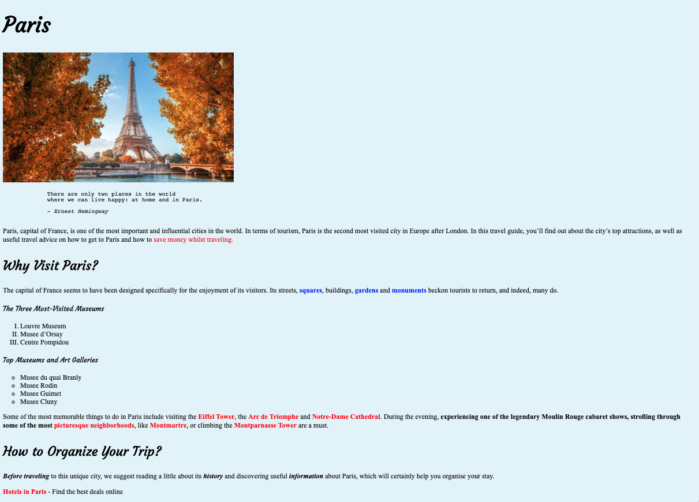
EXERCISE
Favicon
Document Title
External CSS
Body background : #e5f4f9
Headings’ font-family : 'Courgette’ (from google fonts)
Paragraphs’ font-family: ‘Times New Roman’
Image’s height is 300px
Be careful about lists’ list-style-type
Link should open in new Tab and on hover color will change to green
This is the link url :
https://www.introducingparis.com/hotels

